Slide 1
SMART PARKING SYSTEM USING IOT SENSORS & ML

Slide 2
OVERVIEW
Abstract
Introduction
Problem statement
Objectives
Literature Review
Existing System
Proposed System
Module Description
Work Flow Block Diagram
Use case diagram
Software Requirements
Hardware Requirements
Implementation
Testing
Result
Future Scope
Conclusion
References
Appendix

Slide 3
ABSTRACT
Traffic and parking inefficiencies in crowded public spaces lead to significant time wasted searching for available spots, heavy reliance on manual management, and the inability to provide real-time updates on parking availability.
The proposed Smart Parking System uses IoT sensors and machine learning to automate the process of detecting vacant parking spaces and managing the overall parking system efficiently, reducing dependency on manual efforts.
This system provides real-time updates on parking availability, minimizes human intervention, and enhances convenience, making parking faster and more organized.

Slide 4
INTRODUCTION
Rapid urbanization has led to increased vehicular traffic, making parking management a significant challenge in public spaces.
Traditional parking systems are inefficient, relying on manual effort and lacking real-time updates, causing time loss and user frustration.
The Smart Parking System integrates IoT sensors (e.g., IR sensors) to detect vehicles and provide real-time availability updates.

Slide 5
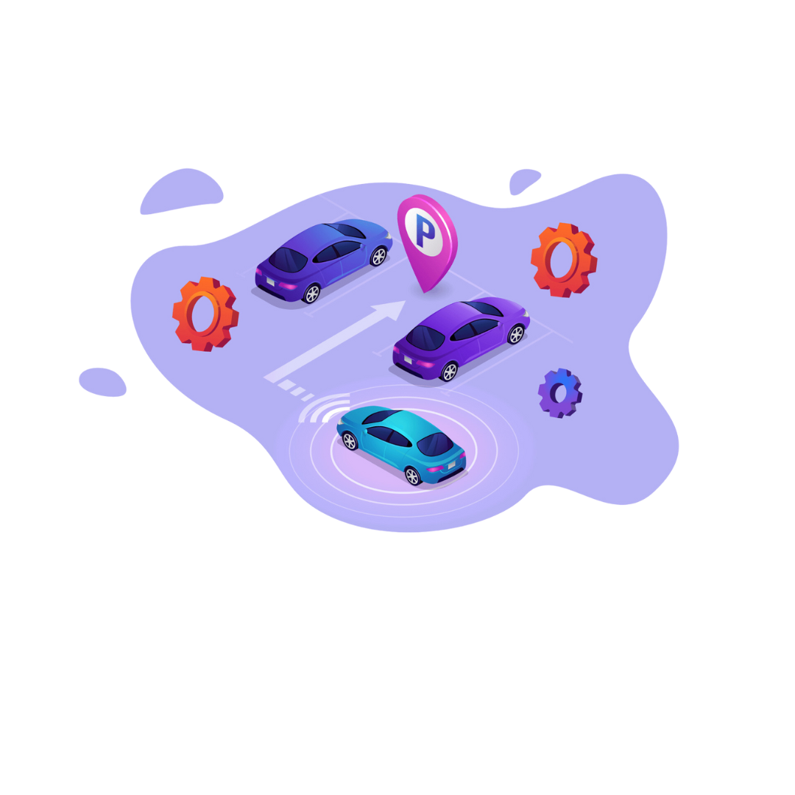
INTRODUCTION contd…
Machine learning enhances vehicle classification, enabling automated and efficient parking management.
The system reduces human intervention, minimizes traffic congestion, and improves user convenience.

Slide 6
PROBLEM STATEMENT
Time Wasted by Drivers: Drivers spend a significant amount of time searching for available parking spaces, leading to frustration, delays, and increased fuel consumption.
Lack of Automation in Existing Systems: Most parking systems rely on outdated methods without real-time updates or automated processes, making them inefficient and inconvenient.
High Costs of Manual Monitoring: Parking lots often depend on manual monitoring, which increases labor costs and results in inefficiencies and potential errors in space management.
Traffic and Environmental Impact: The absence of an effective parking solution contributes to traffic congestion, unnecessary emissions, and a poor overall experience for users and operators.

Slide 7
OBJECTIVES
Efficient Parking Management: Automate the process of detecting and managing parking spaces to save time and reduce manual effort.
Real-Time Space Availability: Provide instant updates on parking slot availability for a seamless user experience.
Vehicle Detection and Classification: Use IoT sensors and machine learning to accurately identify and classify vehicles (e.g., cars and bikes)

Slide 8

Minimize Traffic Congestion: Reduce delays caused by searching for parking spots, improving overall traffic flow in busy areas.
Enhance User Convenience: Deliver a streamlined and user-friendly parking system to improve satisfaction and reduce frustration.

Slide 9
LITERATURE REVIEW
(Paper 1)
Autonomous Parking-Lots Detection with Multi-Sensor Data Fusion UsingMachine Deep Learning TechniquesKashif Iqbal, Sagheer Abbas1, Muhammad Adnan Khan, Atifa Athar, MuhammadSaleem Khan, Areej Fatima and Gulzar Ahmad – 2021
The rapid advancements in deep learning enhance vision-based tasks like object detection and classification, benefiting applications such as autonomous vehicles and ADAS (Autonomous Driver Assistance Systems).
The system uses Mask R-CNN and Inception CNN models for detecting, labeling, and segmenting vehicles in video streams with high accuracy (up to 97.6%) and minimal error rates.
With technologies like semantic segmentation, AR/VR, and explainable AI, CNN-based systems can revolutionize machine capabilities, enabling them to "see and talk," solving real-world challenges efficiently.

Slide 10
(Paper 2)
Machine Learning and IoT based Real Time Parking System: Challenges and Implementation : Ravi Kumar Gupta, Geeta Rani - 2020
The proposed system addresses the inefficiencies of traditional parking methods, which struggle to manage increasing vehicle numbers and space utilization, aiming to offer a hassle-free experience using IoT and machine learning technologies.
Key technologies such as RFID, sensors, HD cameras, and Raspberry Pi are integrated to enhance functionality. RFID is used for automated vehicle tracking, while sensors and cameras monitor parking conditions, ensuring accurate and real-time data collection.
The system provides real-time updates on parking slot availability through digital displays, while a graphical user interface (GUI) enables administrators to easily manage parking statuses. The vehicle entry and exit are automatically tracked using RFID, enhancing security and efficiency.

Slide 11
(Paper 3)
Survey of Smart Parking Systems Mathias Gabriel Diaz Ogás , Ramon Fabregat and SilvanaAciarPublished - 2020
SPS includes Parking Reservation Systems (PRS), Parking Guidance Systems (PGIS), and Crowdsourcing in Intelligent Transportation Systems (CITS), using technologies like sensors, CCTV, and RFID.
Vehicle detection techniques (CCTV, RFID) and algorithms (static, dynamic, real-time) are key to determining parking space availability, with dynamic and real-time algorithms being most effective.
While significant advancements have been made in simulations, only 2% of studies report real-world implementations, facing challenges in real-time data, user preferences, and system adaptability.

Slide 12
(Paper 4)
Predicting parking occupancy via machine learning in the web of things Jesper C. Provoost , Andreas Kamilaris , Luc J.J. Wismans, Sander J. van der Drift , Maurice van Keulen Accepted - 2020
The smart parking system efficiently manages urban parking by providing real-time availability updates using advanced technologies like sensors, cameras, and RFID, enhancing user experience and reducing congestion.
The integration of HD cameras, PIR sensors, and a Raspberry Pi central processing unit ensures seamless tracking of vehicles and accurate real-time updates, improving operational efficiency and minimizing the need for human intervention.
The system reduces operational costs and enhances efficiency, with future plans to further improve user experience by introducing a mobile app with GPS functionality to guide users to available parking slots.

Slide 13
(Paper 5)
Implementation of Smart ParkingApplication Using IoT and MachineLearning Algorithms
G. Manjula, G. Govinda Rajulu, R. Anand, and J. T. Thirukrishna Accepted - 2020
The smart parking system aims to tackle urban parking challenges by simplifying the process of finding parking spaces, reducing traffic congestion, and improving the overall user experience.
It integrates IoT for real-time data communication, machine learning algorithms like Mask R-CNN for detecting parking availability, and video surveillance for continuous monitoring, with notifications sent to users via apps or SMS.
Saves time, lowers fuel consumption and emissions, automates parking management, and offers scalable solutions adaptable to various urban settings, with future enhancements like GPS navigation for seamless parking.

Slide 14
EXISTING SYSTEM
Manual Monitoring: Parking spaces are often managed manually, leading to inefficiencies and delays in finding available spots.
Lack of Real-time Updates: Drivers have no way of knowing which parking spaces are available until they arrive.
Increased Congestion: Searching for parking spaces leads to traffic congestion in parking areas.
High Labor Costs: Significant manpower is needed to monitor and manage parking lots.

Slide 15
PROPOSED SYSTEM
Vehicle Detection
IR Sensor is installed at the entry point and in each parking spot.
These sensors detect when a vehicle (car or bike) enters the parking area.
Vehicle Classification
A camera module captures the image of the incoming vehicle.
A machine learning algorithm processes the image to classify either it is a car or a bike.
Algorithm used : Transfer Learning with Convolutional Neural Networks (CNN)
Guiding Vehicles
Based on the classification:
Cars are directed to the left-side parking area.
Bikes are directed to the right-side parking area.
Real-time Monitoring
IR Sensor continuously monitor each parking space to check availability.
When a vehicle occupies or vacates a spot, the system updates the availability status.

Slide 16
MODULE DESCRIPTION
Vehicle Detection Module:
This module uses IoT sensors, such as IR sensors or cameras, to detect vehicles entering the parking lot, capturing their data for further processing.
Vehicle Classification Module:
Using a trained TFLite model in TensorFlow, this module classifies vehicles as cars or bikes, enabling accurate guidance to appropriate parking zones.
Parking Slot Management Module:
This module monitors the availability of parking slots in real time by utilizing IoT sensors installed in individual parking spaces to detect their occupancy status.

Slide 17
Guidance and Display Module:
The system provides real-time guidance to drivers through LED indicators, display boards, directing them to vacant parking slots based on vehicle classification.
5. Control and Integration Module:
Acting as the central processing unit, this module integrates data from sensors, machine learning models, and parking slot availability to ensure seamless system operation and coordination.

Slide 18
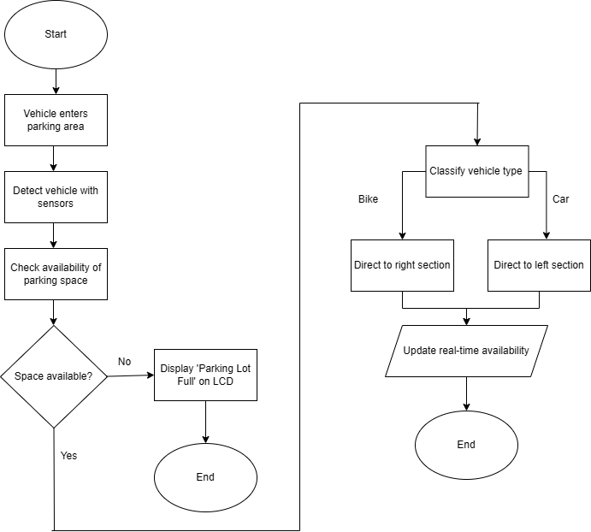
WORK FLOW
DIAGRAM

Slide 19
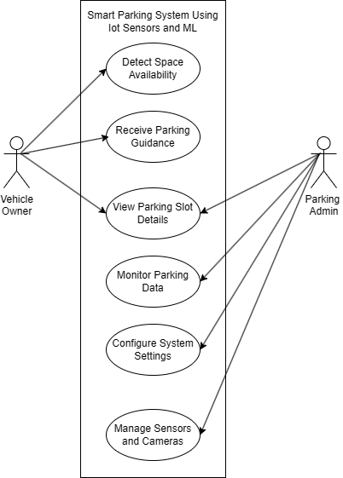
USE CASE
DIAGRAM

Slide 20
SOFTWARE REQUIREMENTS
TensorFlow: An open-source machine learning framework used for vehicle classification (car vs. bike) based on images captured by the camera.
Arduino IDE: A development environment for programming microcontrollers (e.g., Arduino or ESP32) to manage sensors and communicate with cloud systems in the parking system.

Slide 21
HARDWARE REQUIREMENTS
ESP32 WROOM: It is used as a microcontroller.
Arduino: It is used as a microcontroller for ESP32 cam.
IR Sensors: Used to Detect the presence of vehicle at the entrance and differentiate used and empty parking spots.
Servo: MotorShaft moves up when it receives signal from IR Sensor at the entrance.
Camera: Used to categorize different vehicles based on type.
LCD Display: Used to display vacancies in the parking lot.

Slide 22
IMPLEMENTATION
TensorFlow Model for Vehicle Classification
dataset_path = r'D:\Minor Project\Project\Car-Bike-Dataset'
model_path = "vehicle_classification_model.tflite"
def create_generators():
train_datagen = ImageDataGenerator(
rescale=1.0 / 255,
rotation_range=40,
width_shift_range=0.2,
height_shift_range=0.2,
shear_range=0.2,
zoom_range=0.2,
horizontal_flip=True,
validation_split=0.2 # 80% train, 20% validation
)
train_generator = train_datagen.flow_from_directory(
dataset_path,
target_size=(150, 150),
batch_size=32,
class_mode='categorical',
subset='training'
)

Slide 23
IMPLEMENTATION contd…
validation_generator = train_datagen.flow_from_directory(
dataset_path,
target_size=(150, 150),
batch_size=32,
class_mode='categorical',
subset='validation'
)
return train_generator, validation_generator
# Load Data
train_generator, validation_generator = create_generators()
num_classes = len(train_generator.class_indices)
print("Class Indices:", train_generator.class_indices)
# Debugging class mapping
# Load Pretrained MobileNetV2
base_model = MobileNetV2(input_shape=(150, 150, 3), include_top=False, weights='imagenet')
for layer in base_model.layers:
layer.trainable = False

Slide 24
IMPLEMENTATION contd…
# Build Model
x = layers.GlobalAveragePooling2D()(base_model.output)
x = layers.Dense(512, activation='relu')(x)
x = layers.Dropout(0.5)(x)
predictions = layers.Dense(num_classes, activation='softmax')(x)
model = models.Model(inputs=base_model.input, outputs=predictions)
# Compile Model
model.compile(optimizer='adam', loss='categorical_crossentropy', metrics=['accuracy'])
# Train Model
model.fit(train_generator, epochs=10, validation_data=validation_generator)
# Convert to TFLite
tflite_converter = tf.lite.TFLiteConverter.from_keras_model(model)
tflite_model = tflite_converter.convert()
with open(model_path, 'wb') as f:
f.write(tflite_model)
# Prediction Function
def predict_vehicle(image_path):
interpreter = Interpreter(model_path=model_path)
interpreter.allocate_tensors()
input_details = interpreter.get_input_details()
output_details = interpreter.get_output_details()

Slide 25
IMPLEMENTATION contd…
image = cv2.imread(image_path)
image = cv2.cvtColor(image, cv2.COLOR_BGR2RGB)
image = cv2.resize(image, (150, 150))
image = np.expand_dims(image.astype(np.float32) / 255.0, axis=0)
interpreter.set_tensor(input_details[0]['index'], image)
interpreter.invoke()
output = interpreter.get_tensor(output_details[0]['index'])
predicted_class = np.argmax(output[0])
class_labels = {v: k for k, v in train_generator.class_indices.items()} # Correct Mapping
return f"Prediction: {class_labels[predicted_class]} (Confidence: {output[0][predicted_class]:.2f})"

Slide 26
IMPLEMENTATION
Flask Server Code for Vehicle Classification
app = Flask(__name__)
# Directory to save images
UPLOAD_FOLDER = 'uploads'
os.makedirs(UPLOAD_FOLDER, exist_ok=True)
# Load TFLite model and allocate tensors
def load_tflite_model(model_path):
interpreter = tf.lite.Interpreter(model_path=model_path)
interpreter.allocate_tensors()
return interpreter
# Preprocess the input image
def preprocess_image(image_path, input_shape):
img = cv2.imread(image_path)
img = cv2.resize(img, (input_shape[1], input_shape[2])) # Resize to model input size
img = img / 255.0 # Normalize
img = np.expand_dims(img, axis=0).astype(np.float32) # Add batch dimension
return img
# Run inference on the image
def classify_image(interpreter, image_path):
input_details = interpreter.get_input_details()
output_details = interpreter.get_output_details()

Slide 27
IMPLEMENTATION contd…
# Get input shape
input_shape = input_details[0]['shape']
# Preprocess image
image = preprocess_image(image_path, input_shape)
# Set the input tensor
interpreter.set_tensor(input_details[0]['index'], image)
# Run inference
interpreter.invoke()
# Get the output tensor
predictions = interpreter.get_tensor(output_details[0]['index'])
# Assuming the model has 3 classes: ['No Vehicle', 'Bike', 'Car']
class_names = ['Bike', 'Car', 'No Vehicle']
predicted_class = class_names[np.argmax(predictions)]
confidence = np.max(predictions) * 100
return predicted_class, confidence

Slide 28
IMPLEMENTATION contd…
@app.route('/upload-image', methods=['POST'])
def upload_image():
image = request.data
if image:
image_path = os.path.join(UPLOAD_FOLDER, 'captured_image.jpg')
with open(image_path, 'wb') as f:
f.write(image)
# Load the model
model_path = "vehicle_classification_model.tflite"
interpreter = load_tflite_model(model_path)
# Classify the image
predicted_class, confidence = classify_image(interpreter, image_path)
return jsonify({'prediction': predicted_class, 'confidence': f'{confidence:.2f}%'})
return ' No image received', 400
if __name__ == '__main__':
app.run(host='0.0.0.0', port=12345)

Slide 29
TESTING
Sl No | Test Case Name | Test Procedure | Precondition | Expected Result | Actual Result | Remarks
1 | Fn_car_detection | Camera captures image of a car and sends for classification. | Camera is active and capturing live preview. | System correctly detects and classifies the image as "Car" with high confidence. | System correctly detects and classifies the image as "Car" with high confidence. | Passed
2 | Fn_bike_detection | Camera captures image of a bike and sends for classification. | Camera is active and capturing live preview. | System should detect "Bike", but incorrect classification is made ("Car" or "No Vehicle"). | System should detect "Bike", but incorrect classification is made Car | Failed
3 | Fn_bike_detection | Camera captures image of a bike and sends for classification. | Camera is active and capturing live preview. | System correctly detects and classifies the image as "Bike" with high confidence. | System correctly detects and classifies the image as "Bike" with high confidence. | Passed

Slide 30
TESTING contd…
Sl No | Test Case Name | Test Procedure | Precondition | Expected Result | Actual Result | Remarks
4 | Fn_car_parking_block | Camera captures image of a car and sends for classification. | Car parking area is full. Camera is active and capturing live preview. | System detects "Car" and gate remains closed since parking is full. | System detects "Car" and gate remains closed since parking is full. | Passed
5 | Fn_bike_parking_block | Camera captures image of bike and sends for classification. | Bike parking area is full. Camera is active and capturing live preview. | System detects "Bike" and gate remains closed since parking is full. | System detects "Bike" and gate remains closed since parking is full. | Passed

Slide 31
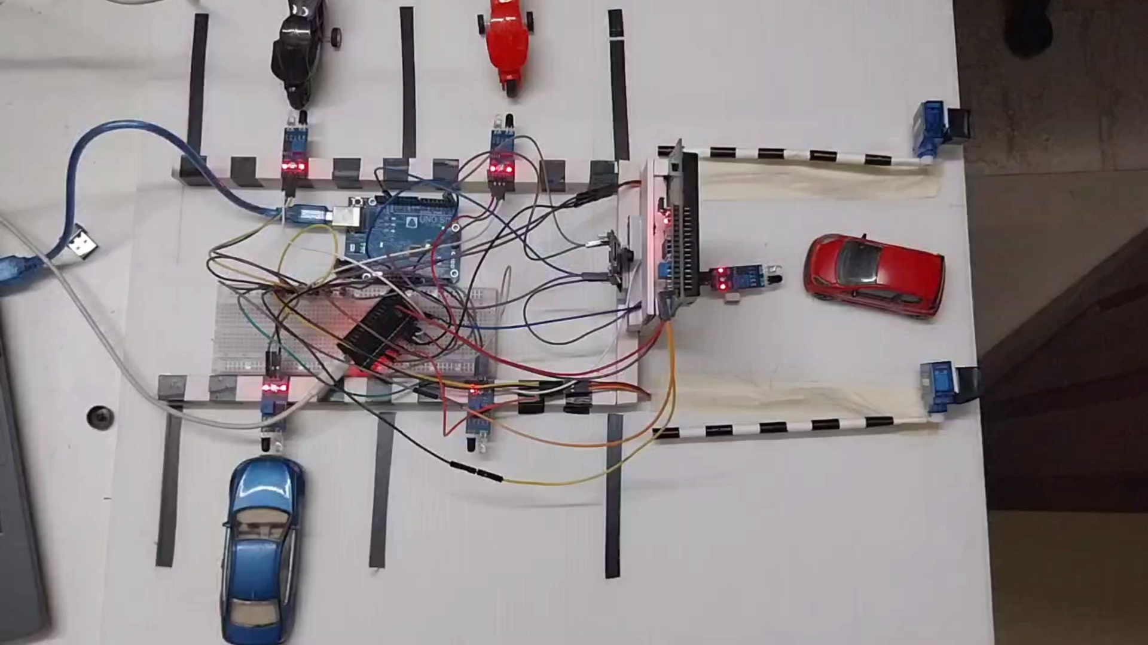
RESULT (Video)

Slide 32
FUTURE SCOPE
AI-Driven ANPR Smart Parking: ANPR automates vehicle entry/exit for registered users, reducing delays. And guide vehicles to available slots, while a future mobile app enables real-time slot booking and updates.
Cloud-Based Monitoring & Analytics: Cloud connectivity enables real-time monitoring, analytics, and efficient remote management of parking spaces. .
Automated Navigation to Reserved Parking: The system will guide vehicles to their reserved parking spots using real-time navigation and IoT-enabled smart signboards, ensuring seamless parking.
Smart Payment System: Future integration of digital payment gateways and RFID-based automated billing will streamline parking fee collection and reduce wait times.

Slide 33
CONCLUSION
The Smart Parking System integrates IoT sensors and machine learning to automate vehicle classification and direct vehicles to available parking spots, improving the overall parking process.
By reducing the time spent searching for vacant parking spaces and minimizing the need for manual intervention, the system enhances operational efficiency and user convenience.
The system not only optimizes parking management but also helps in reducing traffic congestion, offering a smarter and more efficient parking solution for urban areas.

Slide 34
REFERENCES
Autonomous Parking-Lots Detection with Multi-Sensor Data Fusion UsingMachine Deep Learning TechniquesKashif Iqbal, Sagheer Abbas1, Muhammad Adnan Khan, Atifa Athar, MuhammadSaleem Khan, Areej Fatima and Gulzar Ahmad - 2021
Machine Learning and IoT based Real Time Parking System: Challenges and Implementation : Ravi Kumar Gupta, Geeta Rani - 2020
Survey of Smart Parking Systems Mathias Gabriel Diaz Ogás , Ramon Fabregat and SilvanaAciarPublished - 2020
Predicting parking occupancy via machine learning in the web of things Jesper C. Provoost , Andreas Kamilaris , Luc J.J. Wismans, Sander J. van der Drift , Maurice van Keulen Accepted - 2020
Implementation of Smart ParkingApplication Using IoT and MachineLearning Algorithms
G. Manjula, G. Govinda Rajulu, R. Anand, and J. T. Thirukrishna Accepted - 2020

Slide 35
N. Farooqi, S. Alshehri, S. Nollily, L. Najmi and G. Alqurashi et al., “UParking: Developing a smart parking management system using the internet of things,” in 2019 Sixth HCT Information Technology Trends, Ras Al Khaimah, United Arab Emirates: IEEE, pp. 214–218, 2019.
Majeeth, S.S., Babu, C.N.K.: Gaussian noise removal in an image using fast guided filter and its method noise thresholding in medical healthcare application. J. Med. Syst. 43, 280 (2019).
G. Amato, P. Bolettieri, D. Moroni, F. Carrara, L. Ciampi et al., “A wireless smart camera network for parking monitoring,” in IEEE Globecom Workshops, IEEE, Abu Dhabi, UAE, pp. 1–6, 2018.
Bura, H., Lin, N., Kumar, N., Malekar, S., Nagaraj, S., Liu, K.: An edge based smart parking solution using camera networks and deep learning. In: 2018 IEEE International Conference on Cognitive Computing (ICCC), San Francisco, CA, pp. 17–24 (2018).
Patankar,J.B.:Amethodforresizingimagesbycontentperception.In:2017IEEEInternational Conference on Image Processing (ICIP), Beijing, pp. 3725–3729 (2017)

Slide 36
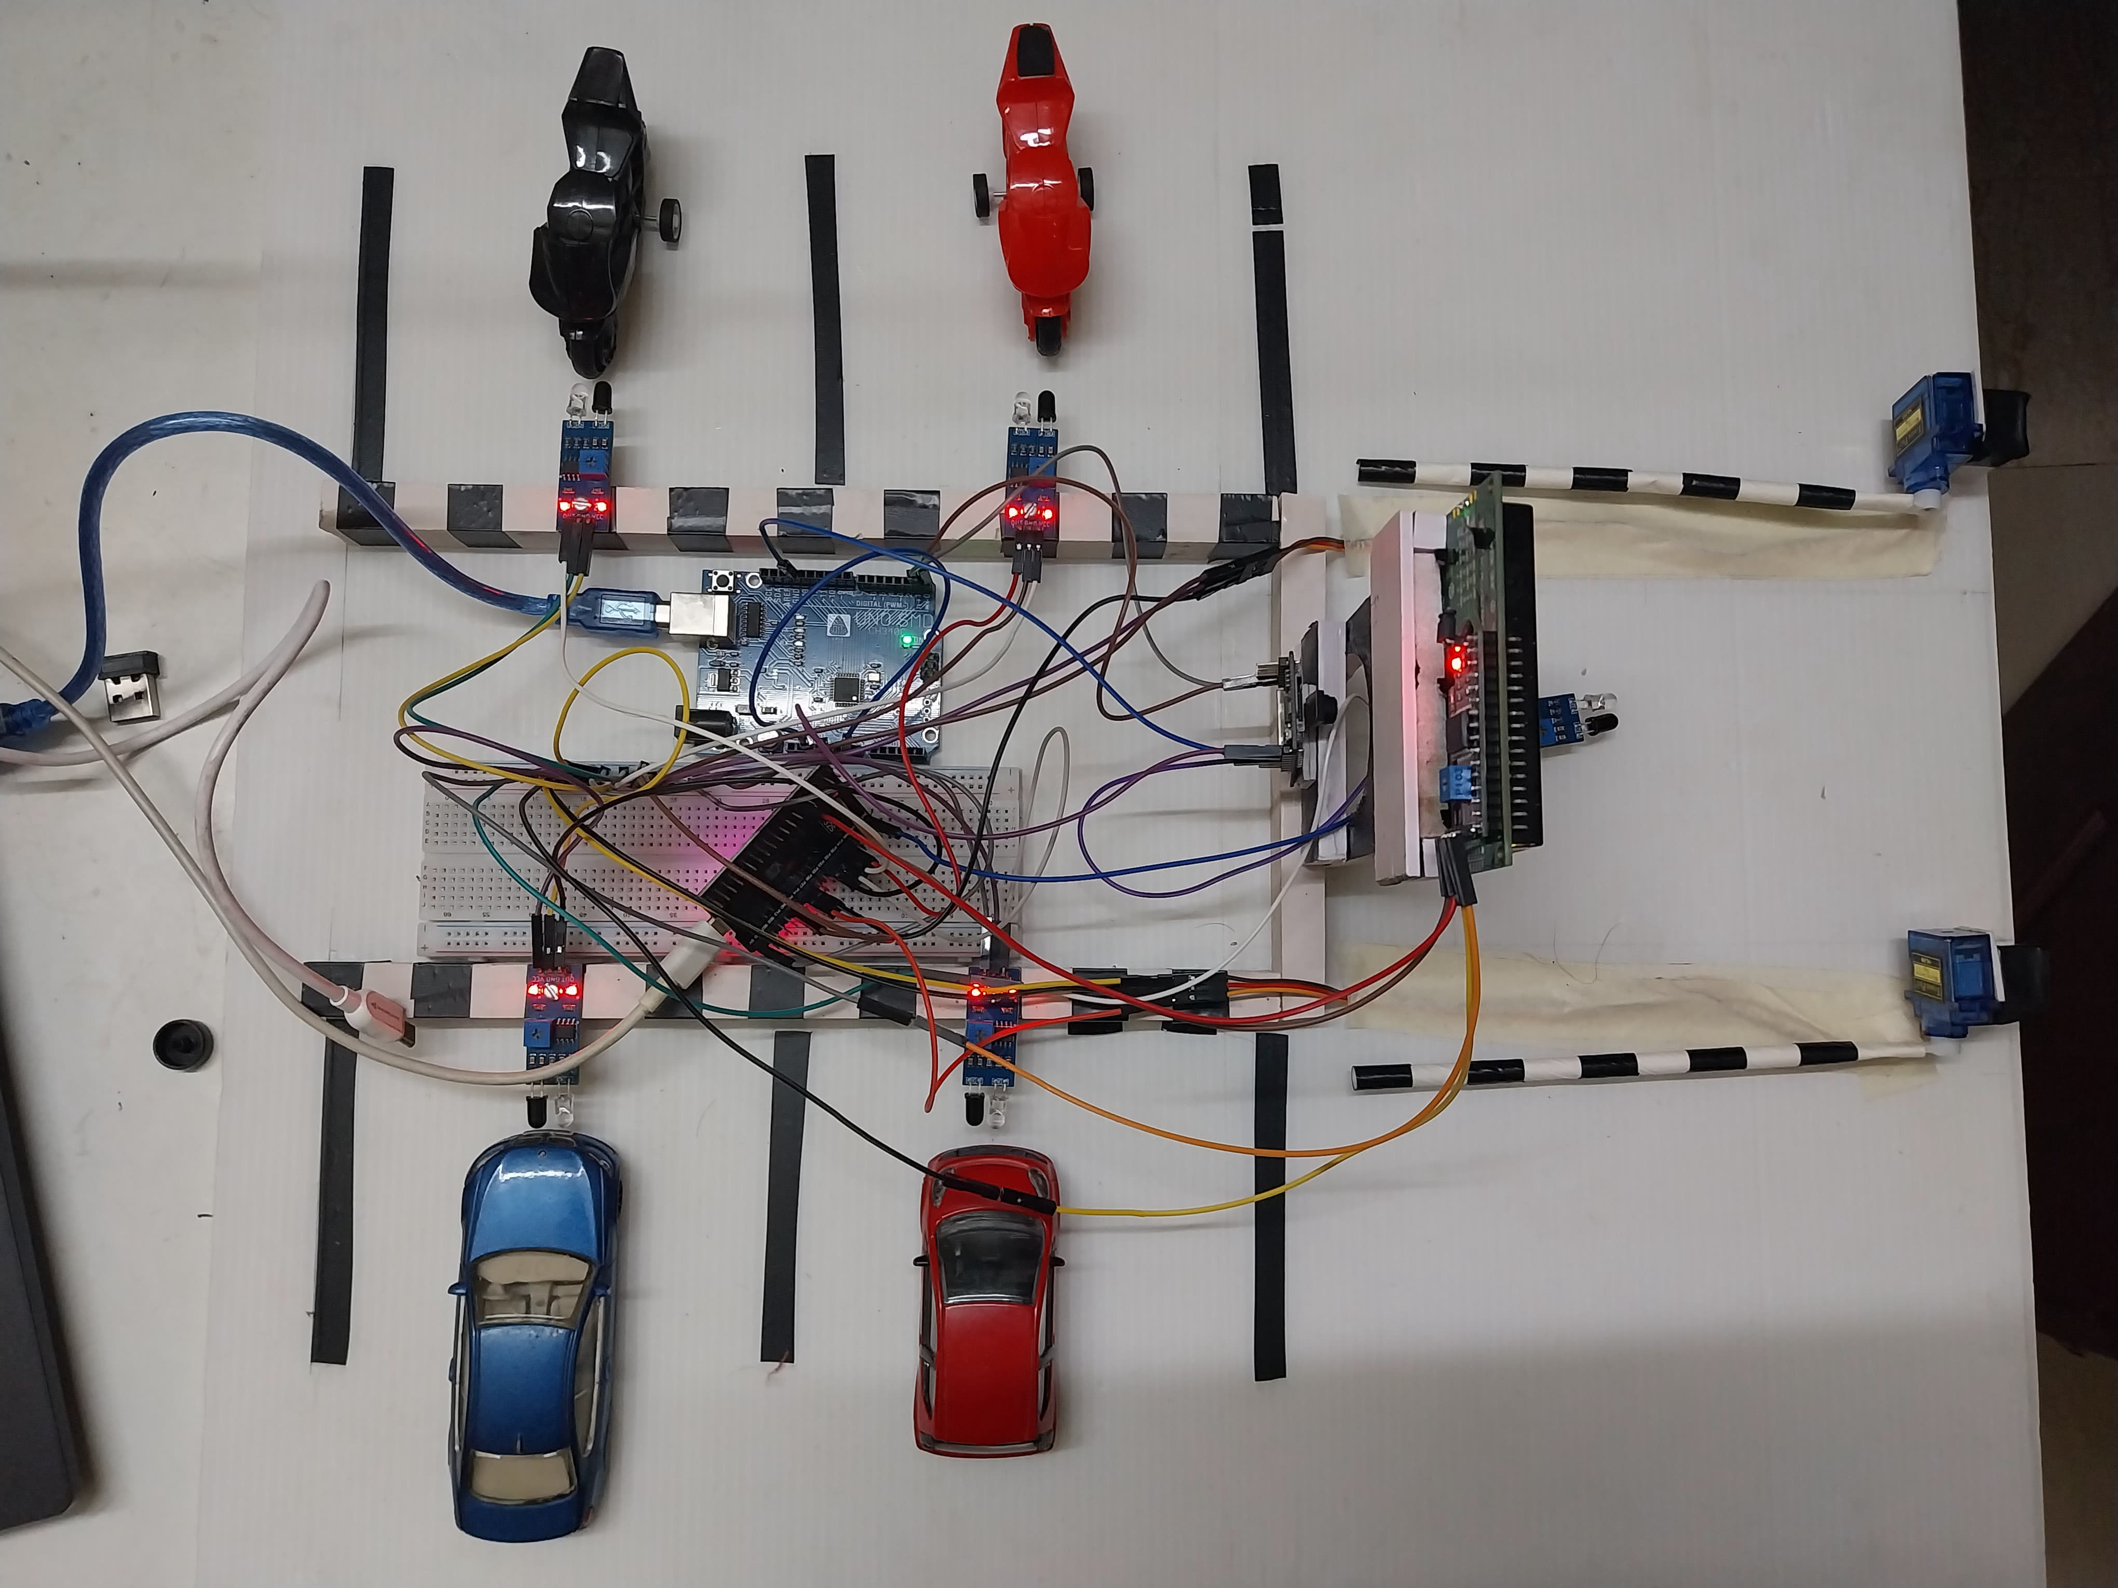
Appendix

Slide 37
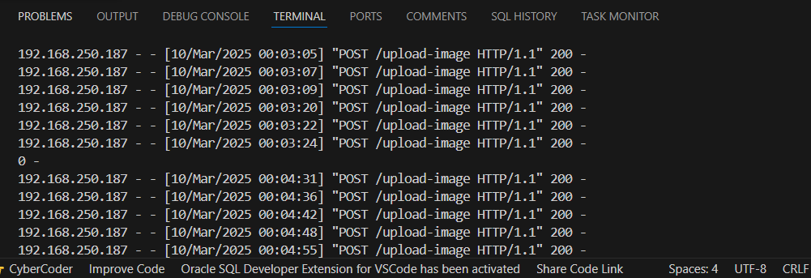
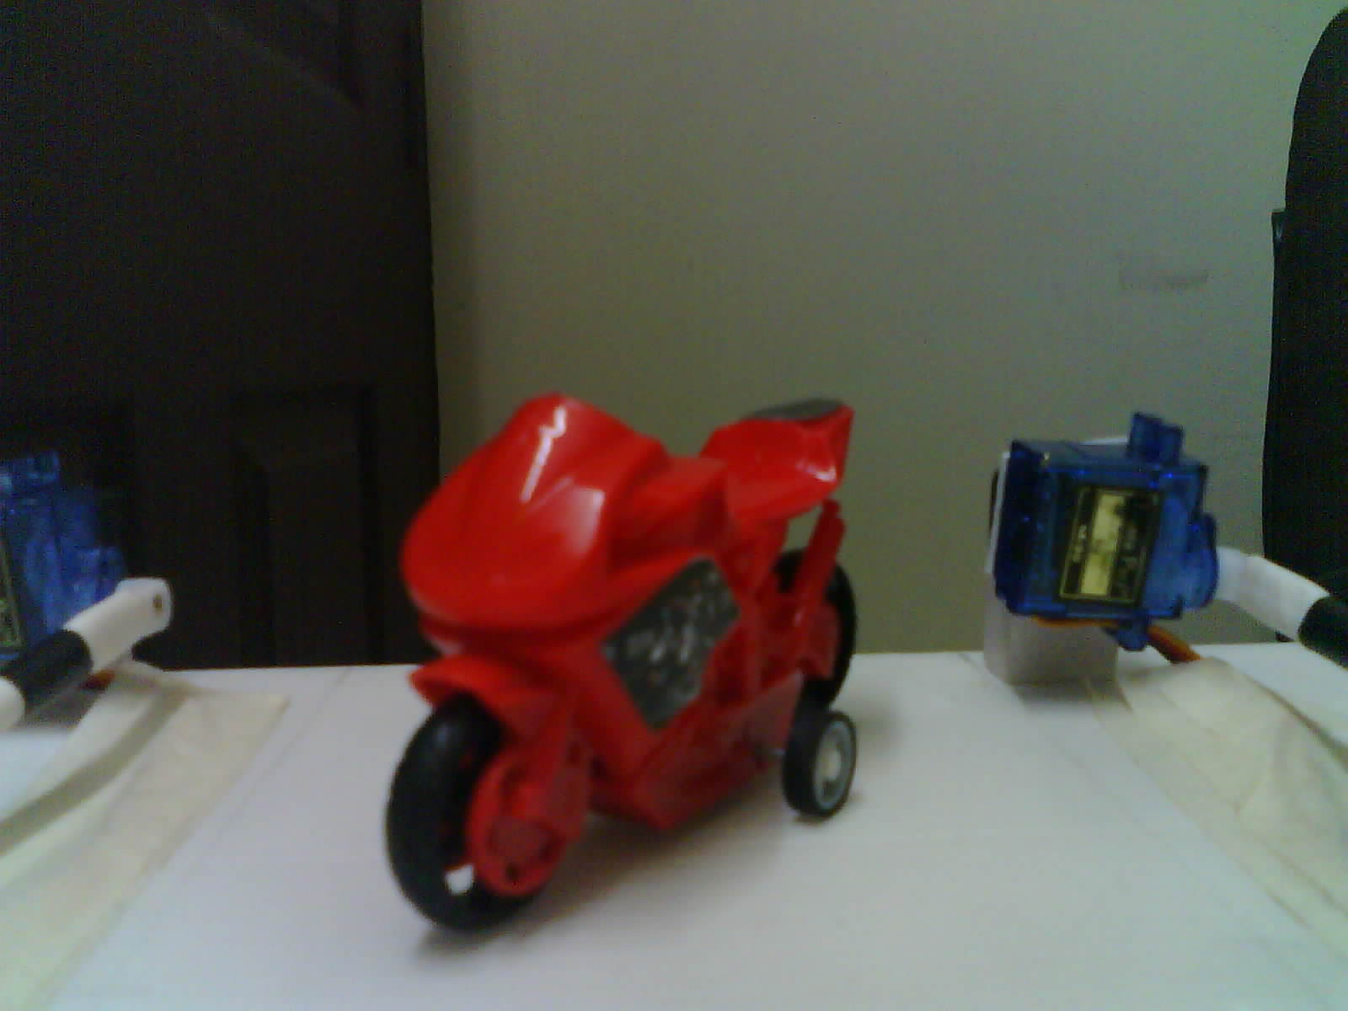
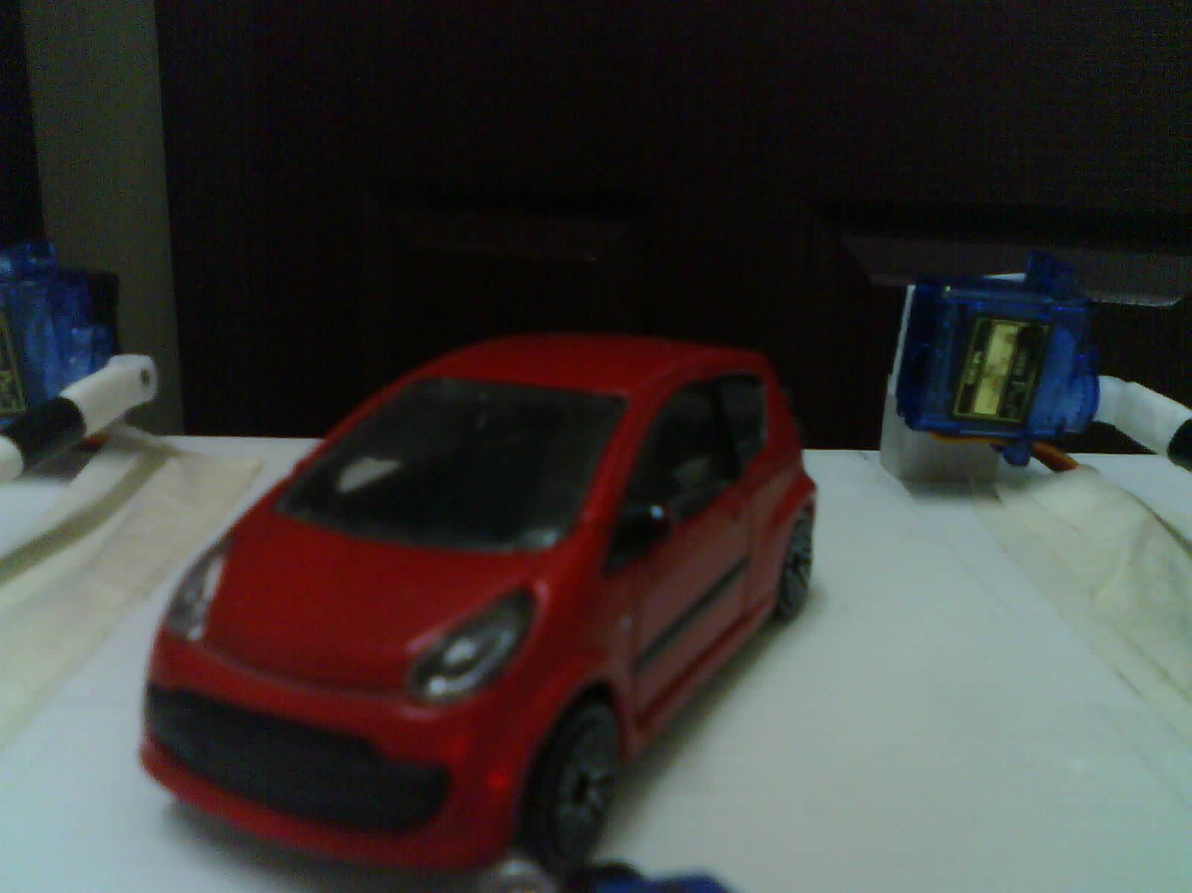
Appendix
Image Received By Flask Server

Slide 38
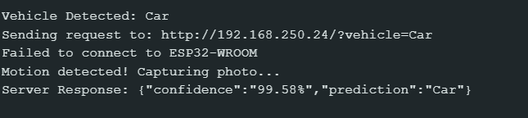
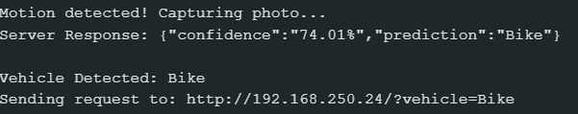
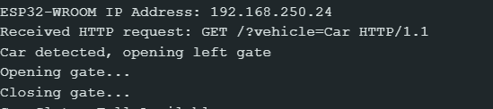
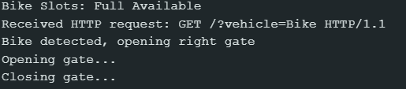
Appendix
Serial Monitor of ESP32 Cam
Serial Monitor of ESP32

Slide 39
THANK YOU

